Slide 1

Consumer and Market Insights: Feminine Hygiene Market in South Korea

Slide 2
Country Context
Market Overview
Retail Landscape and Key Distribution Channels
Packaging
Brand Share
Consumer Trends
Examples of New Product Development
Appendix

Slide 3


Trend 1: Better Value For Money: High unemployment rate and disparity in pay structure have made consumers price conscious
How the Better Value trend will influence the usage of Feminine Hygiene products in South Korea
The South Korean mid-lifer population (20-40) constitute about 48.3% of the population in the employable category. In spite of steady economic growth over the last decade, increasing unemployment in both urban and rural areas and income inequality have considerably reduced the consumers’ purchasing power. Due to these existing differences, women have been increasingly preferring to buy hygiene products in bulk on the internet.
Based on the value for money concept and increasing customer needs, Feminine brands have come up with various promotions using popular web sites like alibaba.com and qoo10.sg
For example, Unicharm Corporation sells their product, ”Sofybodyfit”, for a 50% discount on the original price. Likewise, another Korean brand, Yuhan Kimberley, offers its All Cotton Ultra Wing sanitary pads in a single pack less than the retail price on the internet .
Key demographics to target
Women
Aged 20-40
Urban & Rural
Better Value
Key categories to target
Sanitary Pads
Rate at which the trend will evolve
Fast

Slide 4

Trend 2: Individualism:
How the Trust trend will influence the usage of Feminine Hygiene products in South Korea
Fast-paced lifestyle, tax fee living and high disposable income make most of the young female expat workforce in the UAE to splurge on premium products based on individualistic needs.
To cater to an urban woman’s choice , many international brands have launched premium products for women to maintain hygiene on special days.
For instance, Femfresh, a UK based international company, has introduced a range of products for the intimate skin to maintain better hygiene and PH balance during menstruation..
Their product Ultimate Care Pure and Fresh Wash is PH balanced and blended with the natural ingredients of the lotus flower, which gives a soothing feeling in the intimate area..
Key demographics to target
Women
Aged 21-31
Urban
Individualism
Key categories to target
Internal Cleansers
Rate at which the trend will evolve
Fast

Slide 5
Trend 3: Quality Seeking: Rise in expat population and disposable income in UAE have increased consumers’ choice for premium hygiene products
How the Quality Seeking trend will influence Feminine Hygiene market in South Korea
South Korea’s increasing GDP per capita, steady economic export oriented growth over the years and rise in disposable income in urbanized Seoul have seen an increase in women buying high quality feminine hygiene products.
For instance, Suchehwa brand manufactures its internal cleaners to clean the intimate area from prolonged strong odor . The vaginal sanitizer ‘s inserting nozzle is prepared from a soft material so that people who are using the product for the first time can safely handle it. Also, since there is no risk of bacterial infection and the purified water of 110ml contained in the sanitizer is sprayed into the intimate area for a thorough wash.
Tampax and OB brands offer a wide range of options in their tampons segment based on consumers preference for better comfort , high absorbency factor and smell free feeling..
Key demographics to target
Women
Aged 25-40
Urban
Key categories to target
Quality Seeking
Sanitary Pads
Internal Cleansers
Rate at which the trend will evolve
Fast

Slide 6

Trend 4: Technology: Rising demand in the usage of disposable razors
How the Technology trend will influence the Feminine Hygiene products in South Korea
Disposable razors are hugely in demand and used extensively by the expat women in the UAE. International brands like Bic, Gillette and Super-max strive to cater to the consumer trends by offering superior quality razors for a smooth shave in the intimate areas.
Super-Max brand scores very high on the quality and reliability aspects of their blades.. The company has been trying to improve their product by researching about the material technology and improvising the product design of their shaver blades to meet customer expectation.
For instance, Super-Max razors have launched world’s first battery operated four blade disposable razor that is enriched with Tea tree oil, Aloe vera and Vitamin E to reduce irritation and moisturize the skin. It has a battery-operated pulse system to reduce friction and an Italian-designed handle for better grip.
Key demographics to target
Women
Aged 20-40
Urban
Technology
Key categories to target
Disposable Razors
Rate at which the trend will evolve
Fast

Slide 7
Despite high economic growth ,increasing pay inequalities and high unemployment rate over the last few years would impact consumerism
The following drivers will rise in importance over the next five years to become increasingly influential motivators of consumption within the market.
Despite rapid economic growth, rising income inequality will decrease consumerism
Following the Asian Financial Crisis of 1997-98, the IMF package bailed South Korea out of financial distress. Although, the country has been experiencing robust economic growth since then it didn’t do much to ameliorate the debt –ridden woes of the working middle class and the SMEs.. Furthermore, the country’s two-tier labor market with unequal pay structure ,makes upward mobility difficult, which in turn is affecting consumerism. Thus, the demand for consumer-packaged goods is uneven in the rich urban areas and those urban areas with low-income households.
Increase in online shopping to boost sales for Feminine Hygiene products
In order to save money and experience variety at one go, Koreans choose shopping online for personal care items on American websites such as amazon.com ,ebay.com etc compared to local online stores. Korean subsidiaries of ebay, specializing in this direct purchasing business are growing more prosperous, accelerating the growth of the market. In March 2014, the Korean government has made some reforms by exempting tariffs on a few categories available on these sites. Moreover, the government believes the inflow of lower-priced foreign products would eventually stabilize the domestic price level.

Slide 8
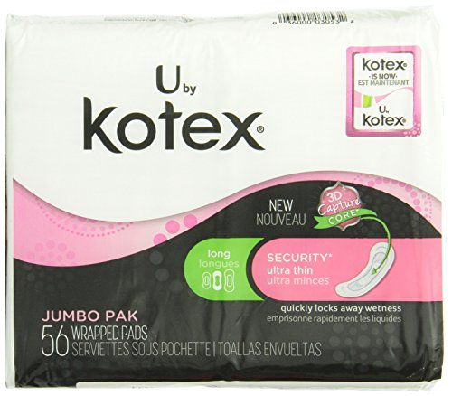
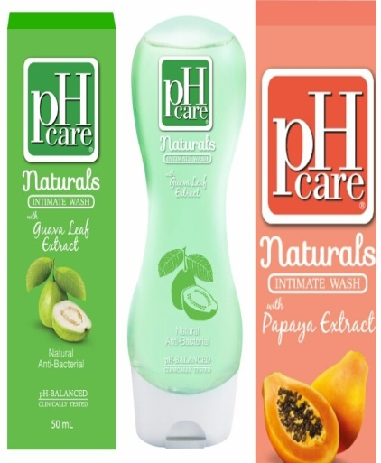
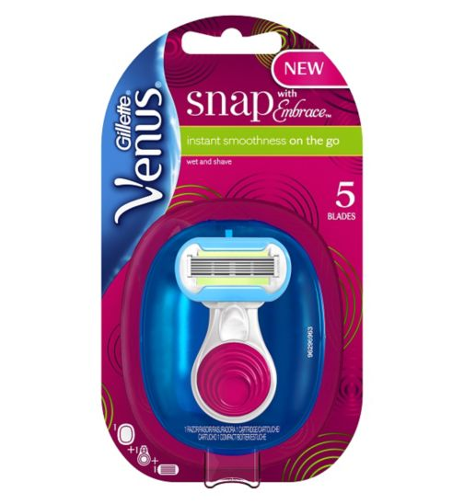

Examples of new product development in the South Korea’s Feminine Hygiene market
Brand: Kotex
Manufacturer: Kimberley Clark Corporation
Kotex has launched its new “jumbo value pack” containing 56 pads at the regular price. Their product is unscented and has the 3D capture core technology that absorbs all the wetness to help stop excess leakage.
Trend alignment: Better Value for Money
Brand: pH care
Manufacturer: pH care
Keeping in mind consumers choices, the pH care brand has introduced the pH Care Naturals Papaya and pH Care Naturals Guava internal cleansers. These contain natural ingredients that are mild in quality and keep the intimate area fresh and clean.
Trend alignment: Quality
Brand: Carefree
Manufacturer: Johnson & Johnson
These pantiliners have a top layer made of soft cotton for quick absorption and is mildly scented with natural Aloe Vera for a fresh and comfortable feeling.
Trend alignment: Individualism
Brand: Gillette
Manufacturer: Procter & Gamble
P&G has designed a new sleek razor that tucks easily into any bag/luggage for the woman on- the- go. The product has five blades surrounded by a protective shield for an easy shave and a mini handle for better grip .
Trend alignment: Technology

